Slide 1
DSA SEMESTER PROJECT
Huffman encoding, Decoding and
compressioN
By:Saqib Javed

Slide 2
MAIN OBJECTIVE
Huffman Algorithm is actually used for lossless data compression.
The main objective was to compress the data by using Huffman Algorithm so that it will be useful to save files in an easy and efficient way in terms of memory.

Slide 3
MAIN PROBLEM
To encode the file in such a way that is not understandable.
To compress the file so that the size is less than the original text file.

Slide 4
HUFFMAN ALGORITHM
Step 1: Find frequency of each character.
Step 2: Make priority queue.
Step 3: Build Huffman tree.
Step 4: Generate binary codes.
Step 5: Encode the file.

Slide 5
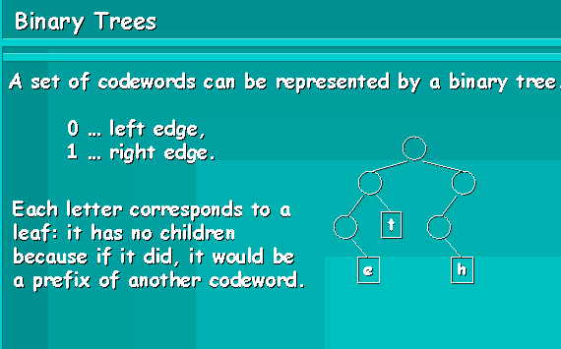
HUFFMAN TREE

Slide 6
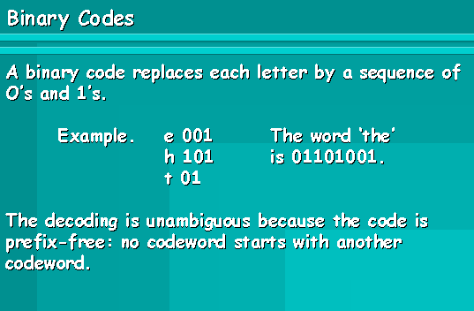

Slide 7
COMPRESSION
Algorithm:
Pick 8 bits from encoded file and build 1 character value for it.
Write this new character into new compressed file.
Follow this step till the end of encoded file.
At the end, the size of compressed file will be less than the original text file.

Slide 8
COMPLEXITY ANALYSIS
Reading Characters from file:
O (n*m) where n is number of sentences in the text file and m is the length of sentence
Priority Queues:
Insertion: O (n-1) where n is the number of nodes already present in it.
Deletion: O (1) because deletion is always at front end.
Encoding:
O (n*h) where n is number of characters in the text file and h is the height of the Huffman tree.
Compression:
O (n + m) where n is number of octets in the encoded file and m is number of message bits that are left.
Decompression:
O (n + m) where n is number of octets in the encoded file and m is number of message bits that are left.
Decoding:
O (b) where b is number of bits (0’s and 1’s) in encoded file.

Slide 9
ADVANTAGES
Compressed file is obtained which has less size.
Encoding aspect assures security.
Decoding gives exact copy of original file.

Slide 10
REFRENCES
http://michael.dipperstein.com/huffman/
http://www.cs.auckland.ac.nz/~jmor159/PLDS210/huffman.html
http://msdn.microsoft.com/en-us/library/336xbhcz.aspx
http://www.slideserve.com/gwendolyn/data-compressor-huffman-encoding-and-decoding

Slide 11
DEMO

